Slide 1
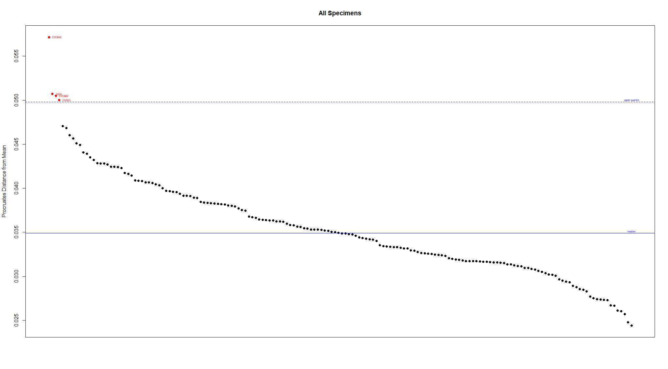
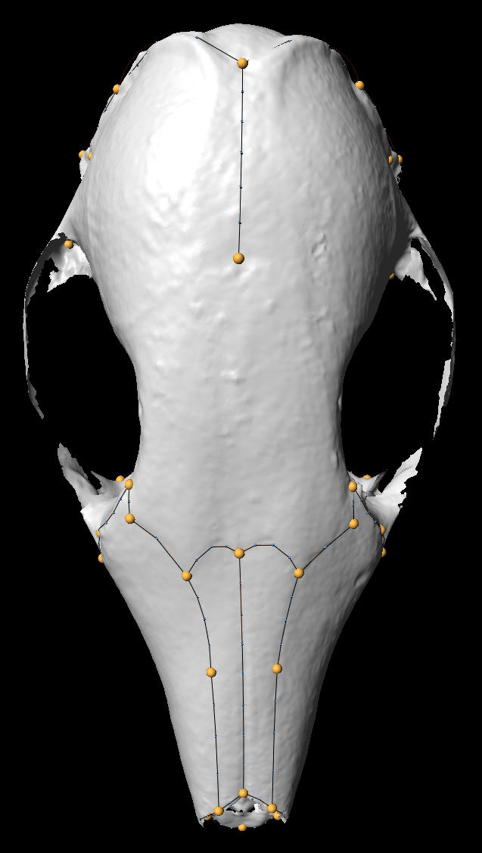
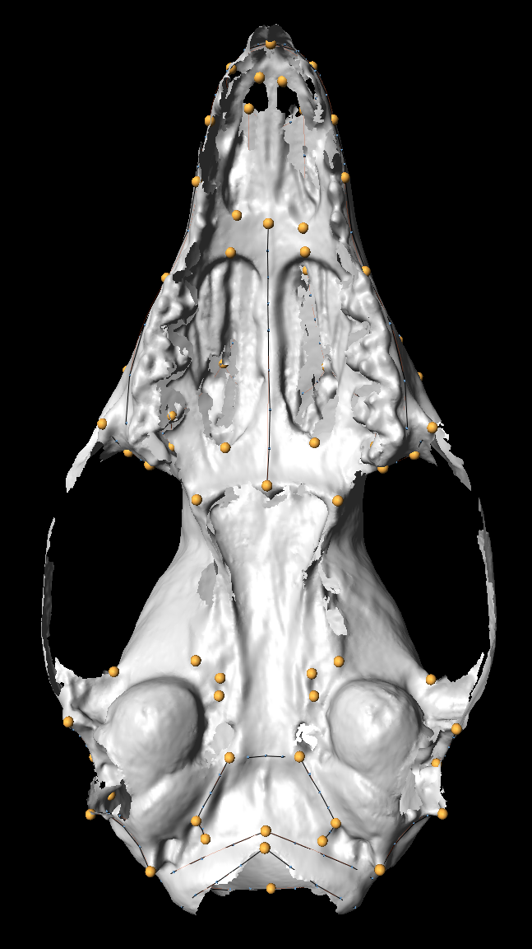
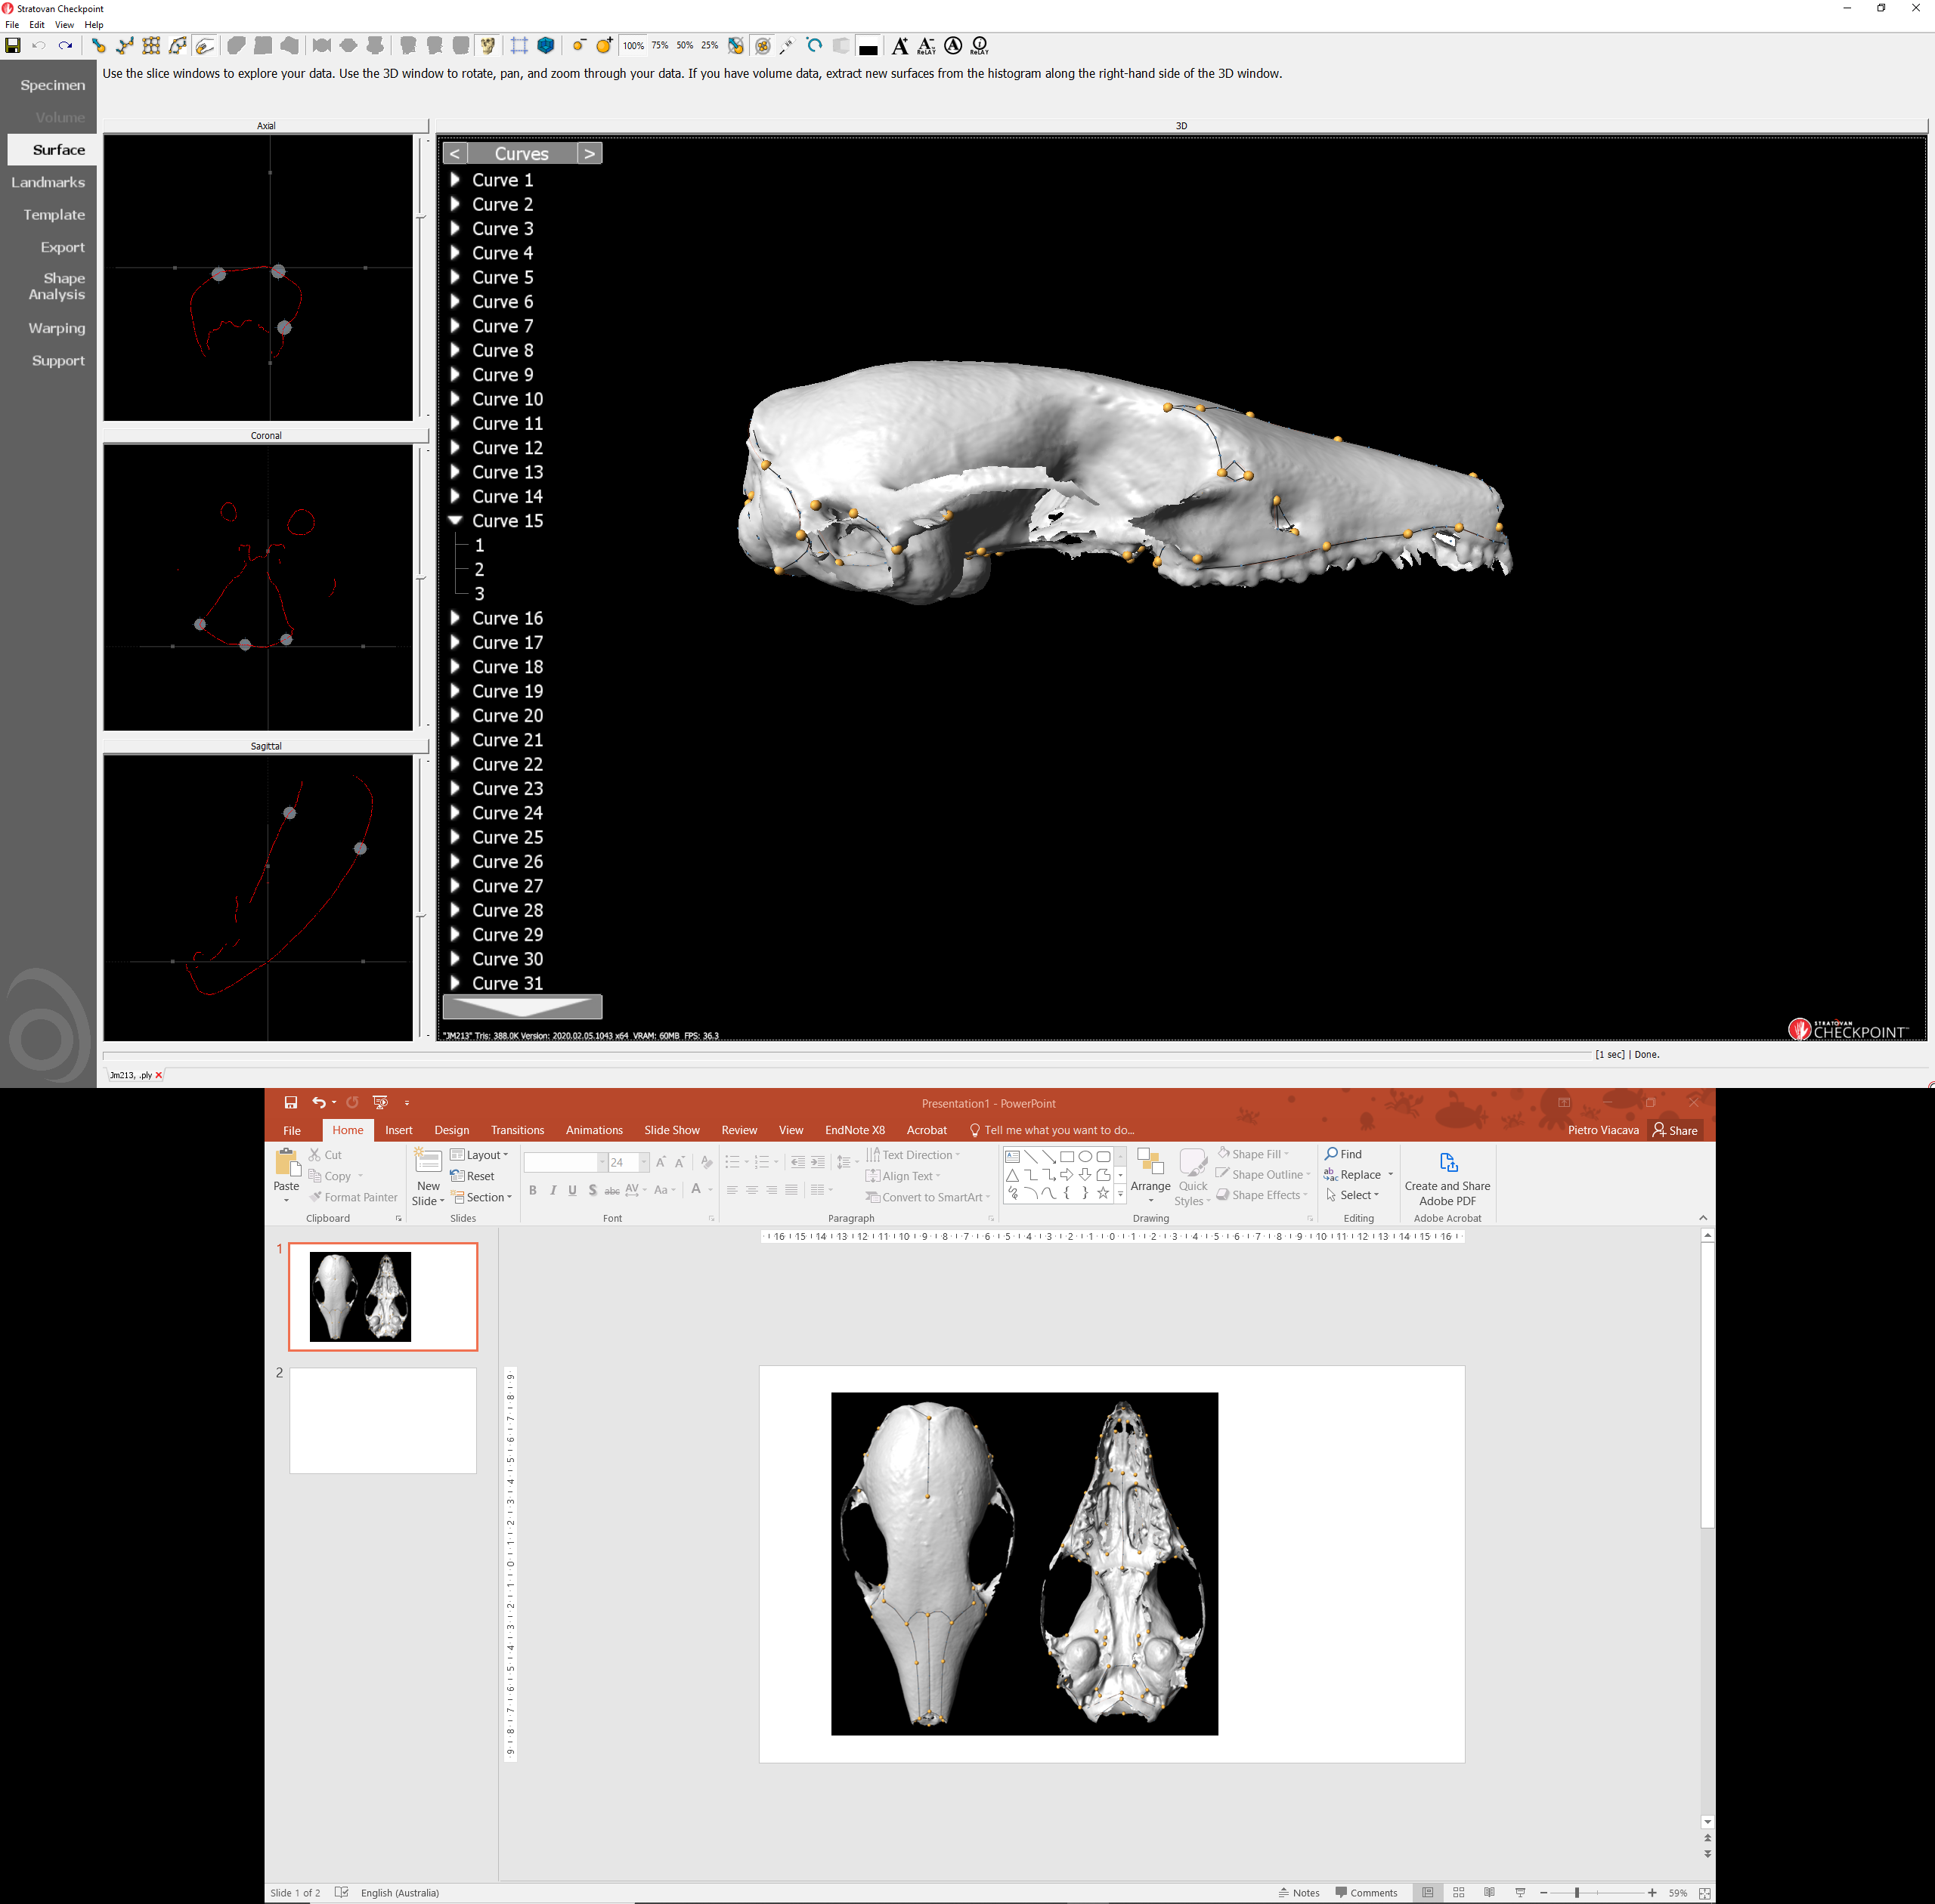
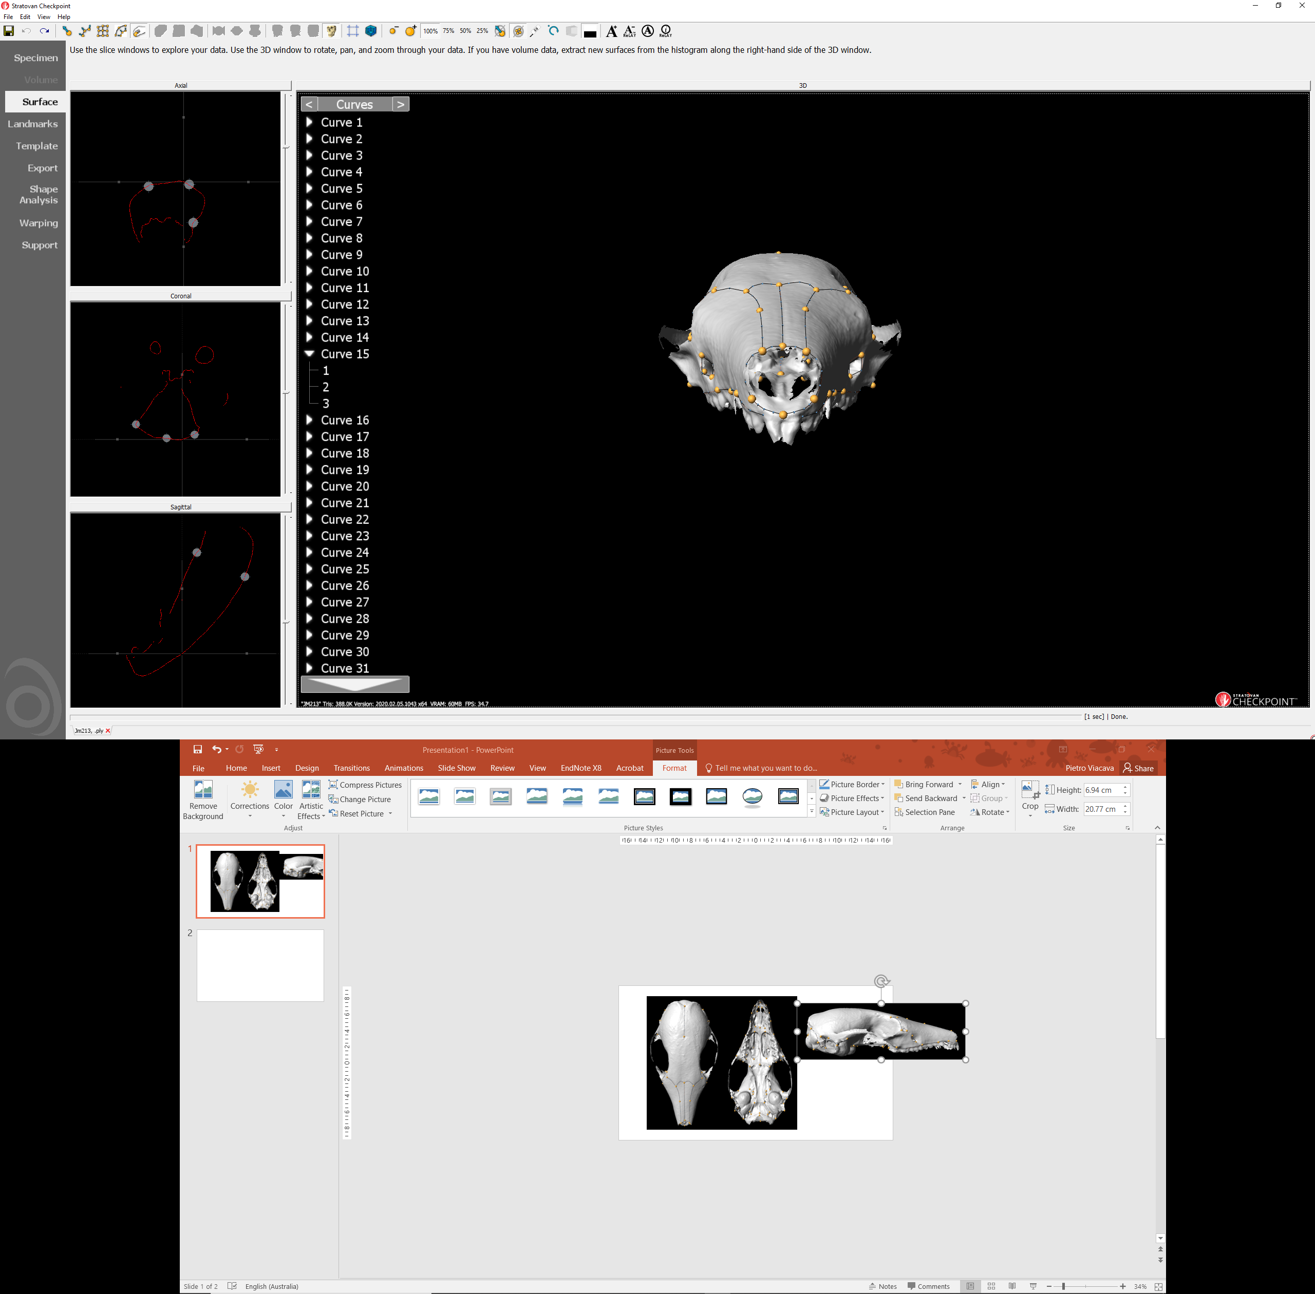
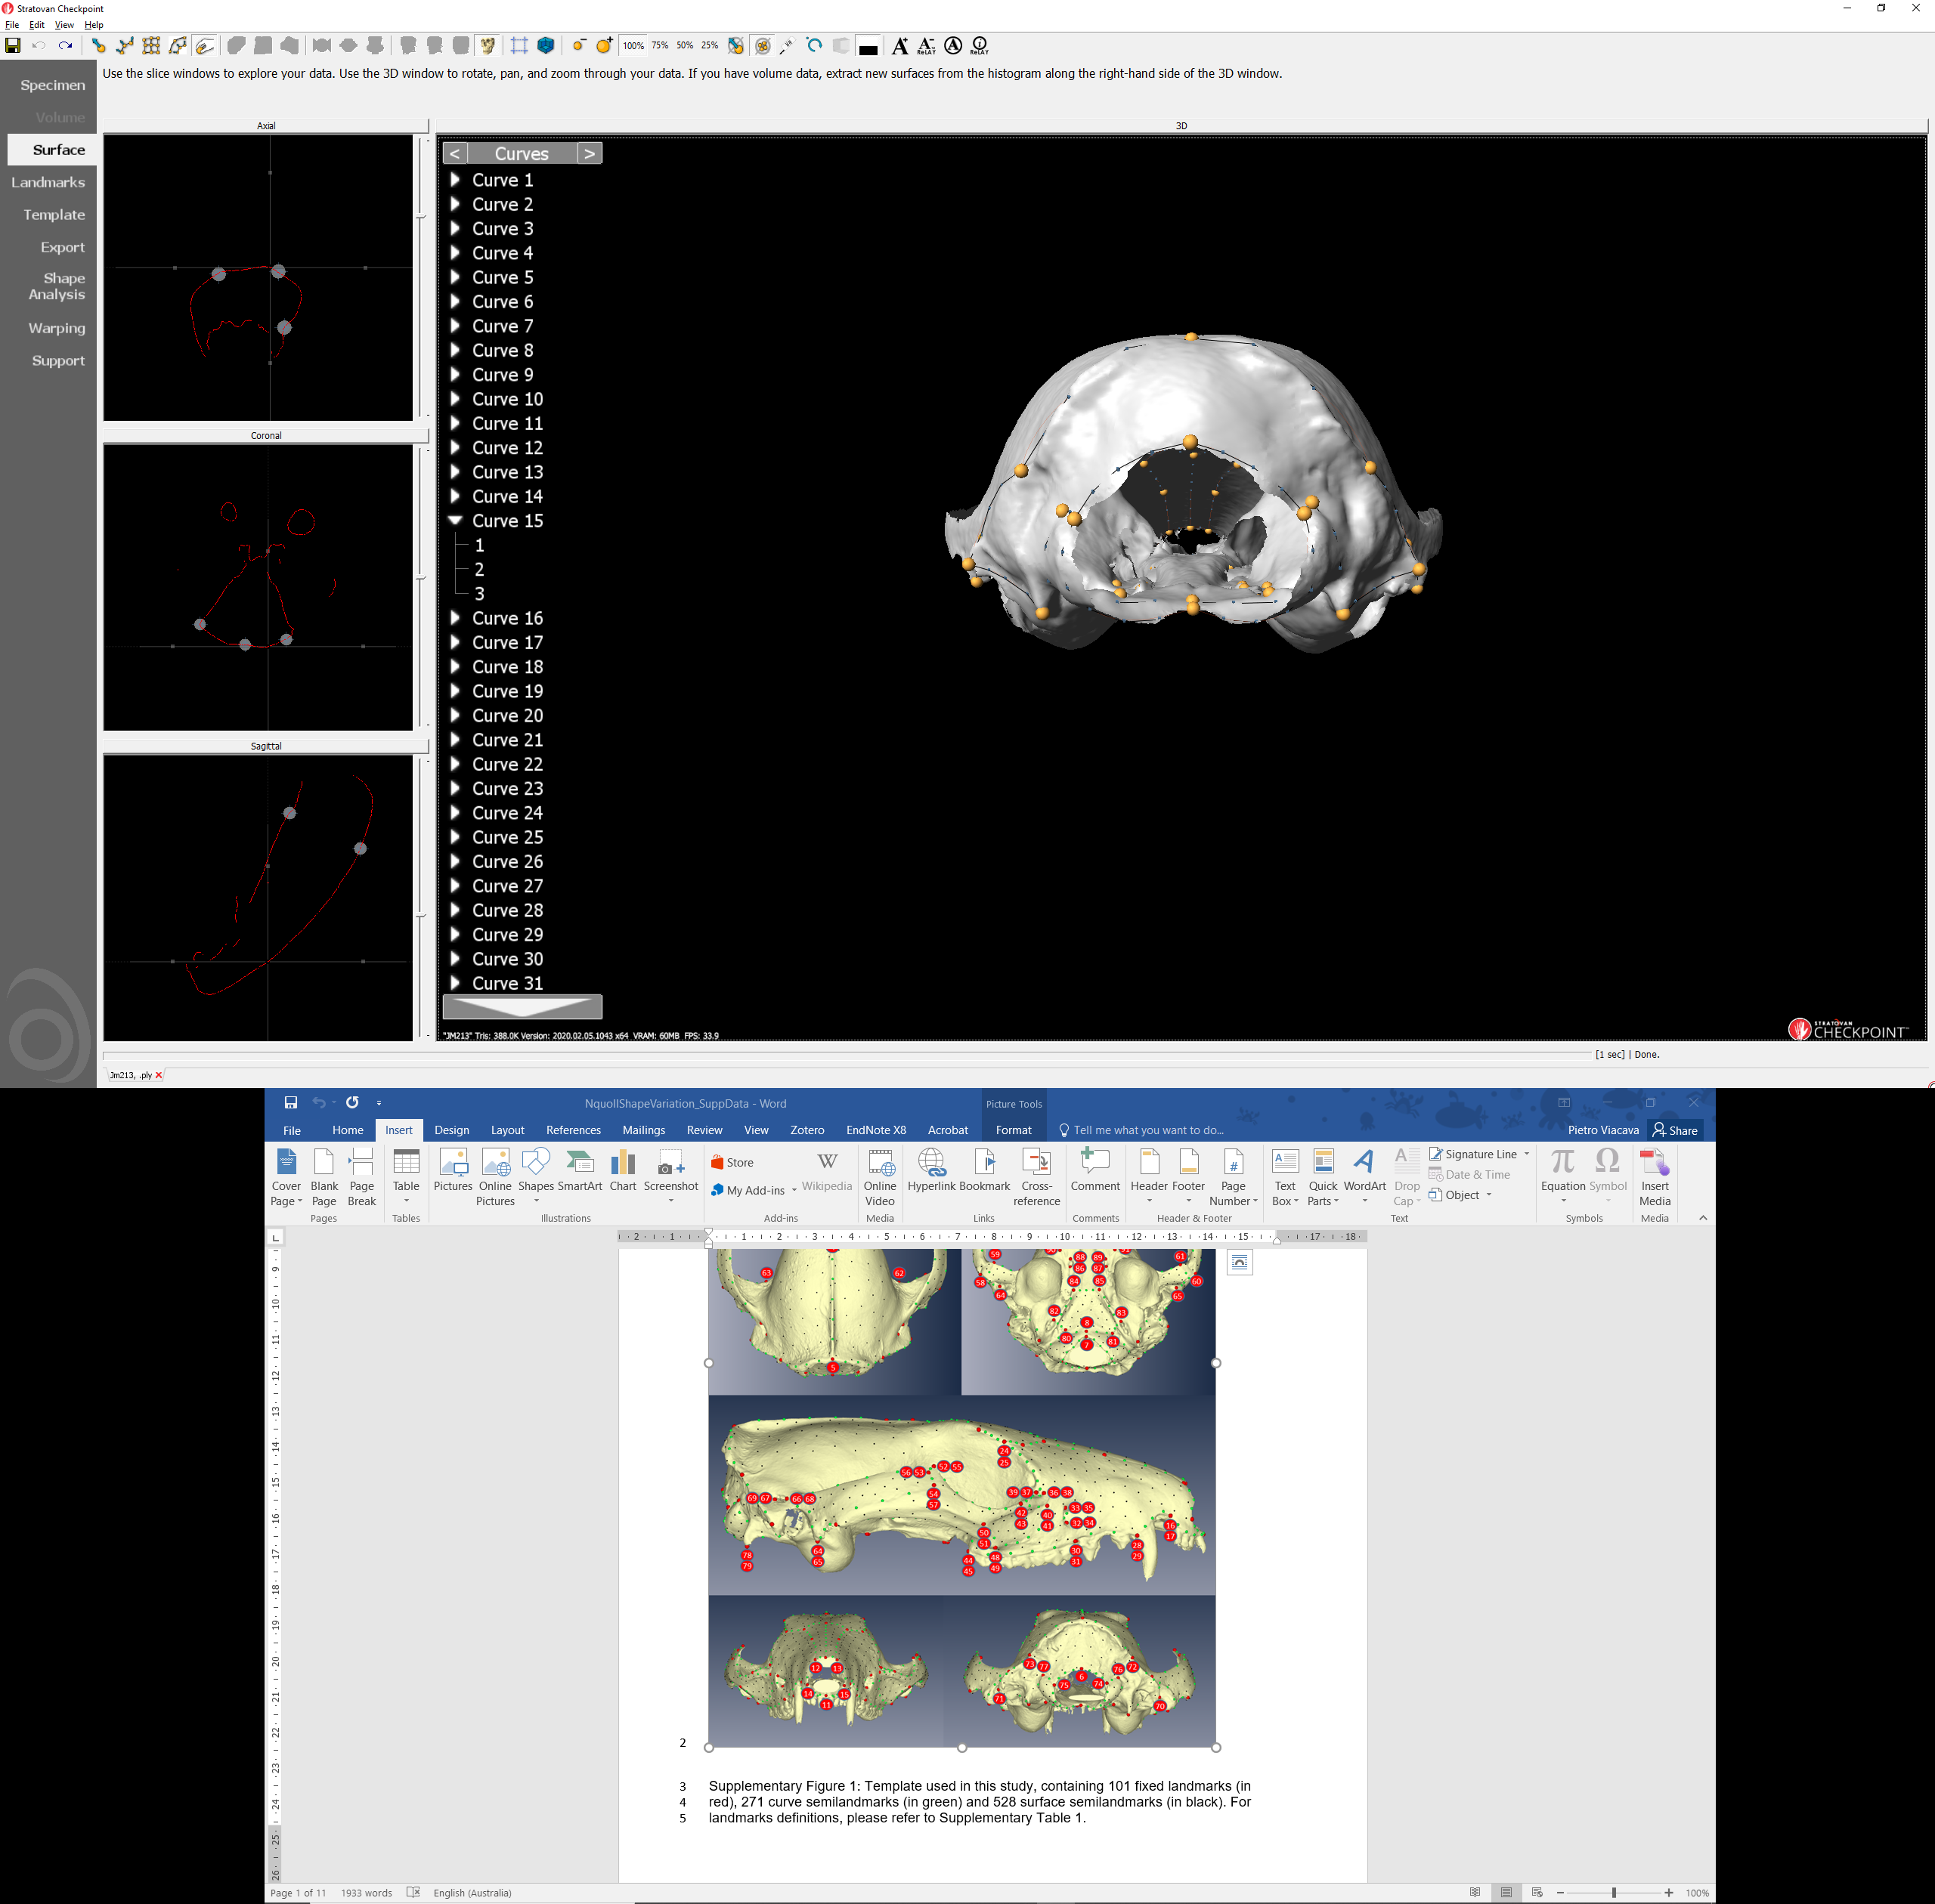
188 specimens scanned, of which:
8 were omitted from landmarking
180 specimens landmarked, of which:
6 were omitted from analysis because were juvenile
4 believed to be other species
1 outlier (Procrustes distance from mean, upper quartile)
169 specimens for analysis, of which:
68 females, 91 males, 10 unknown
67 subtropicus, 39 south stuartii, 23 north stuartii, 40 dubious (holotype)
4
81
82
79
23
21
19
18
9
80
53
24
22
77
78
54
34
33
3
48
47
36
35
30
51
50
49
32
29
25
15
13
52
45
37
41
31
27
26
16
14
59
46
38
42
28
41
39
37
75
76
38
40
42
60
23
24
73
8
74
2
20
4
21
22
19
17
18
5
19
2
20
43
71
69
70
72
30
11
1
12
32
54
58
57
53
45
67
68
44
46
41
29
31
42
52
56
55
51
17
18
63
65
7
66
64
13
10
14
60
6
59
1
59
61
6
62
60
11
12
5

Slide 2
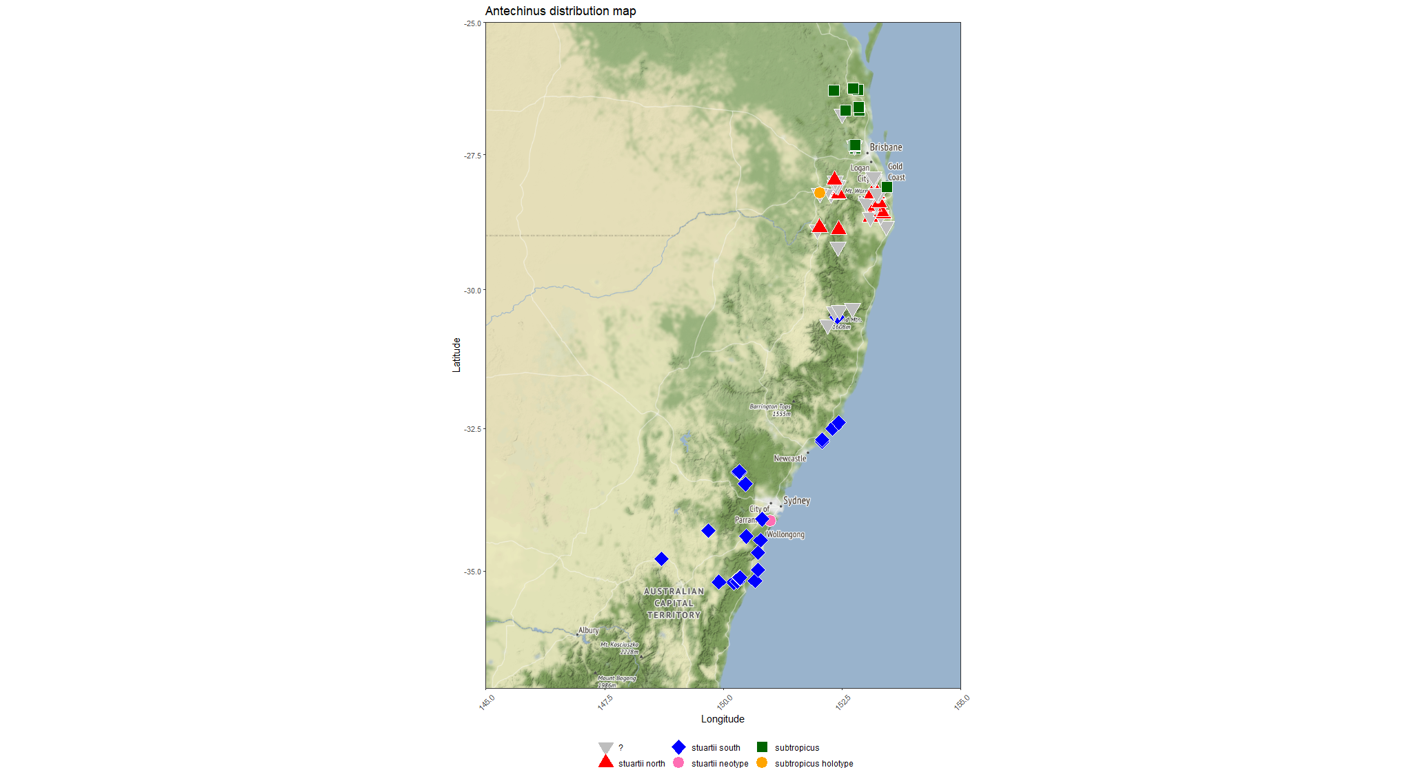

Slide 3
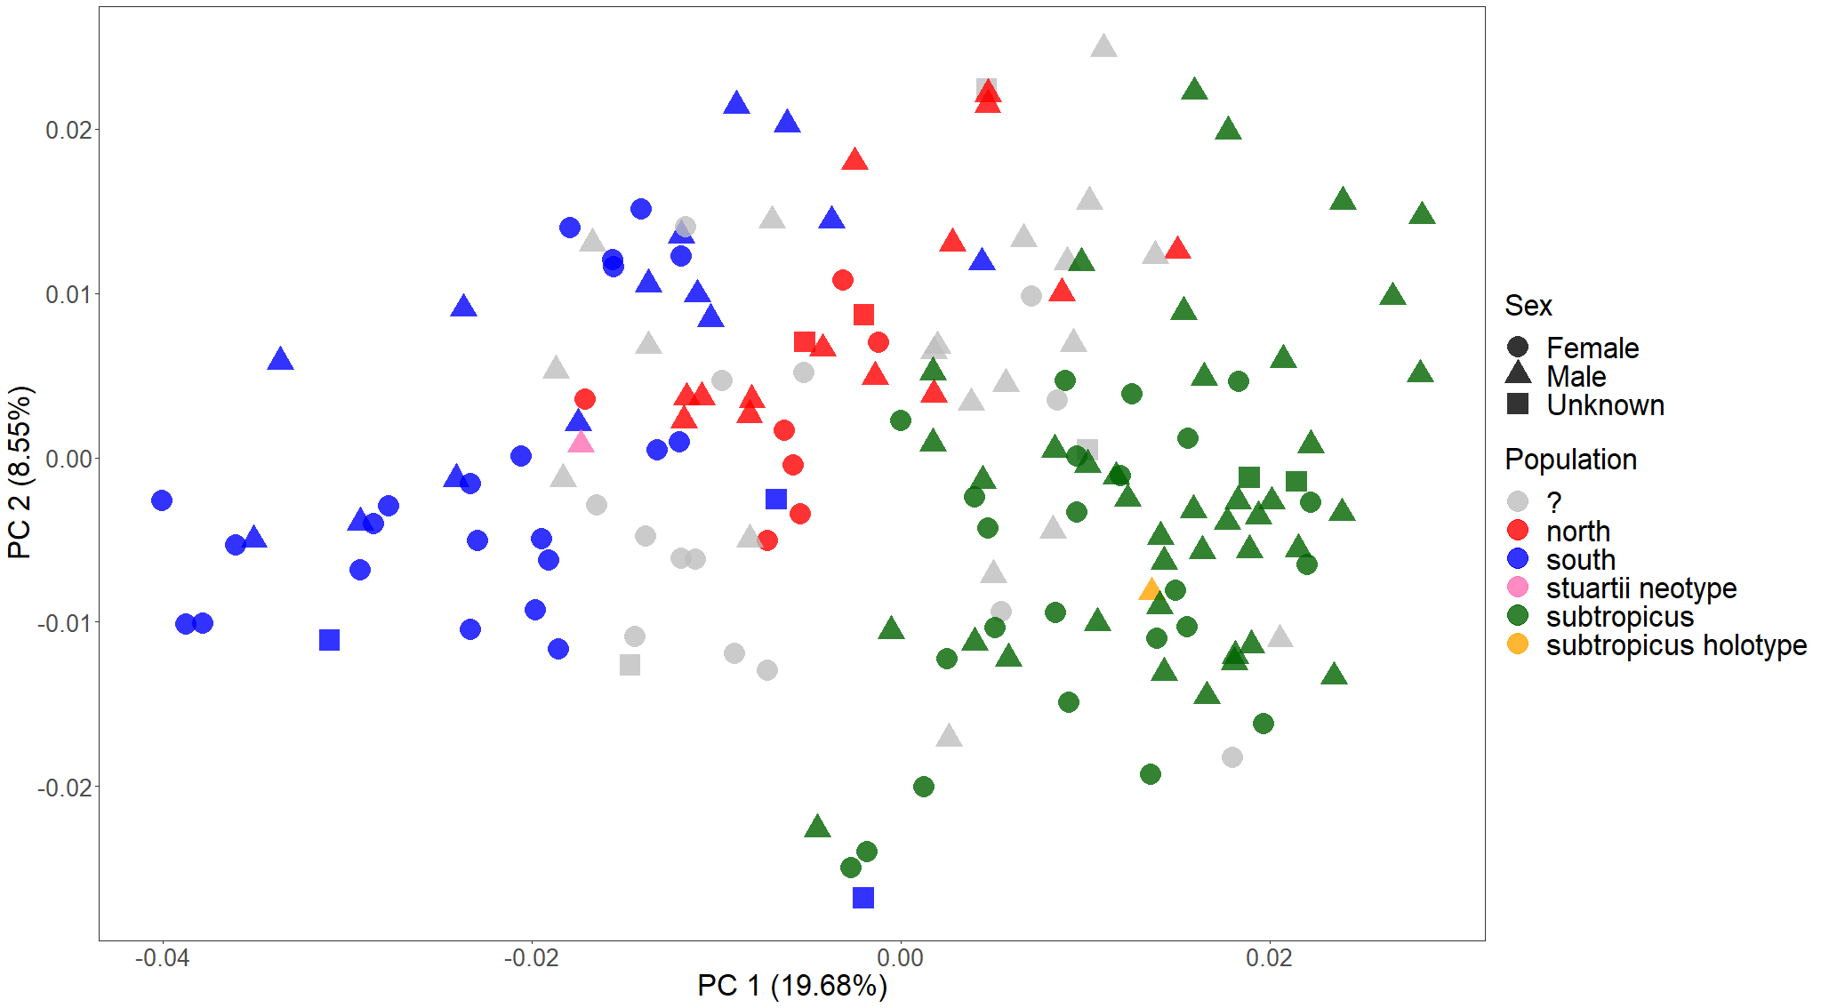
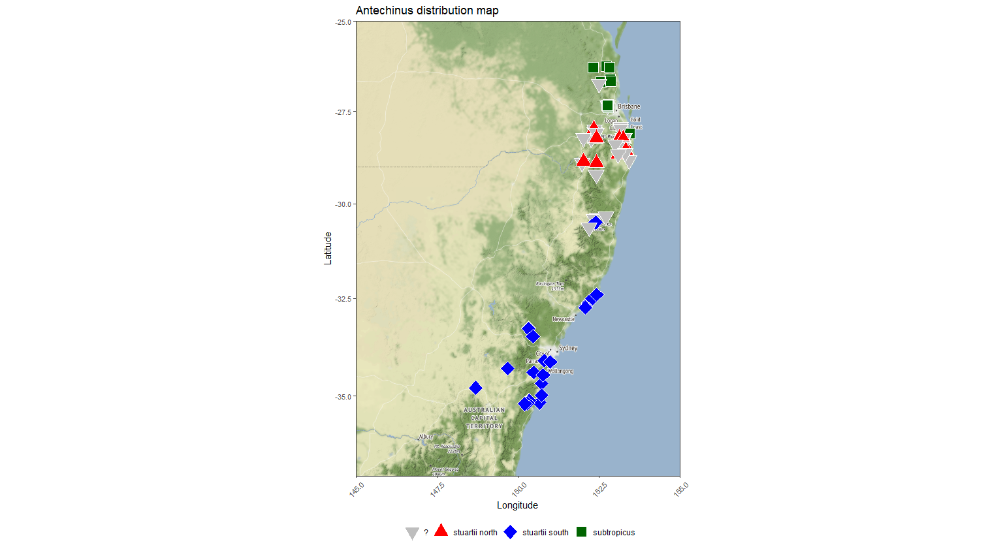
PCA on all specimens, including unknown sex and dubious population identity

Slide 4
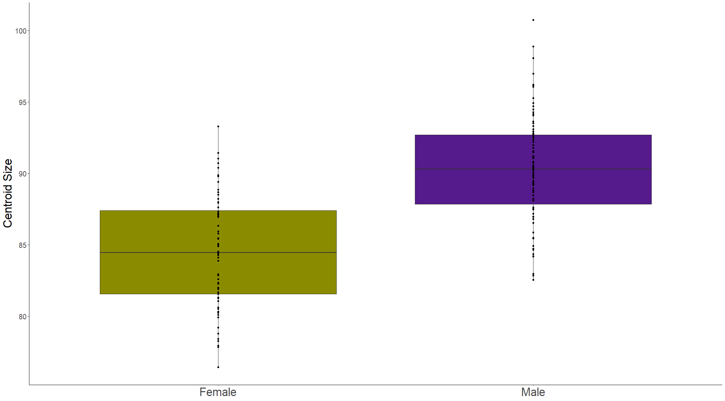
Sex as a predictor of size variation
Adj. R² = 0.355
F_{1,157} = 87.92
p < 0.001

Slide 5
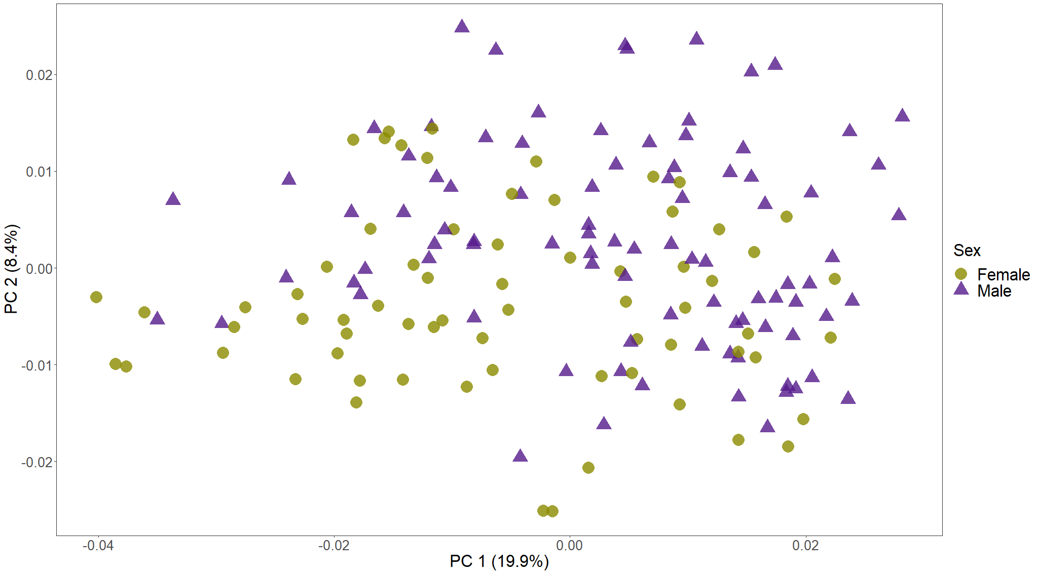
Procrustes ANOVAs
Are sexes different in shape?
(shape~sex)
R² = 0.038
F_{1, 157} = 6.197
p = 0.001
Do they have unique allometries? (shape~size*sex)
R² = 0.005
F_{1, 155} = 0.919
p = 0.556
Adjusting for size, are sexes different in shape? (shape~size+sex)
R² = 0.014
F_{1, 156} = 2.451
p = 0.003
PCA on all specimens, labelling only sex

Slide 6
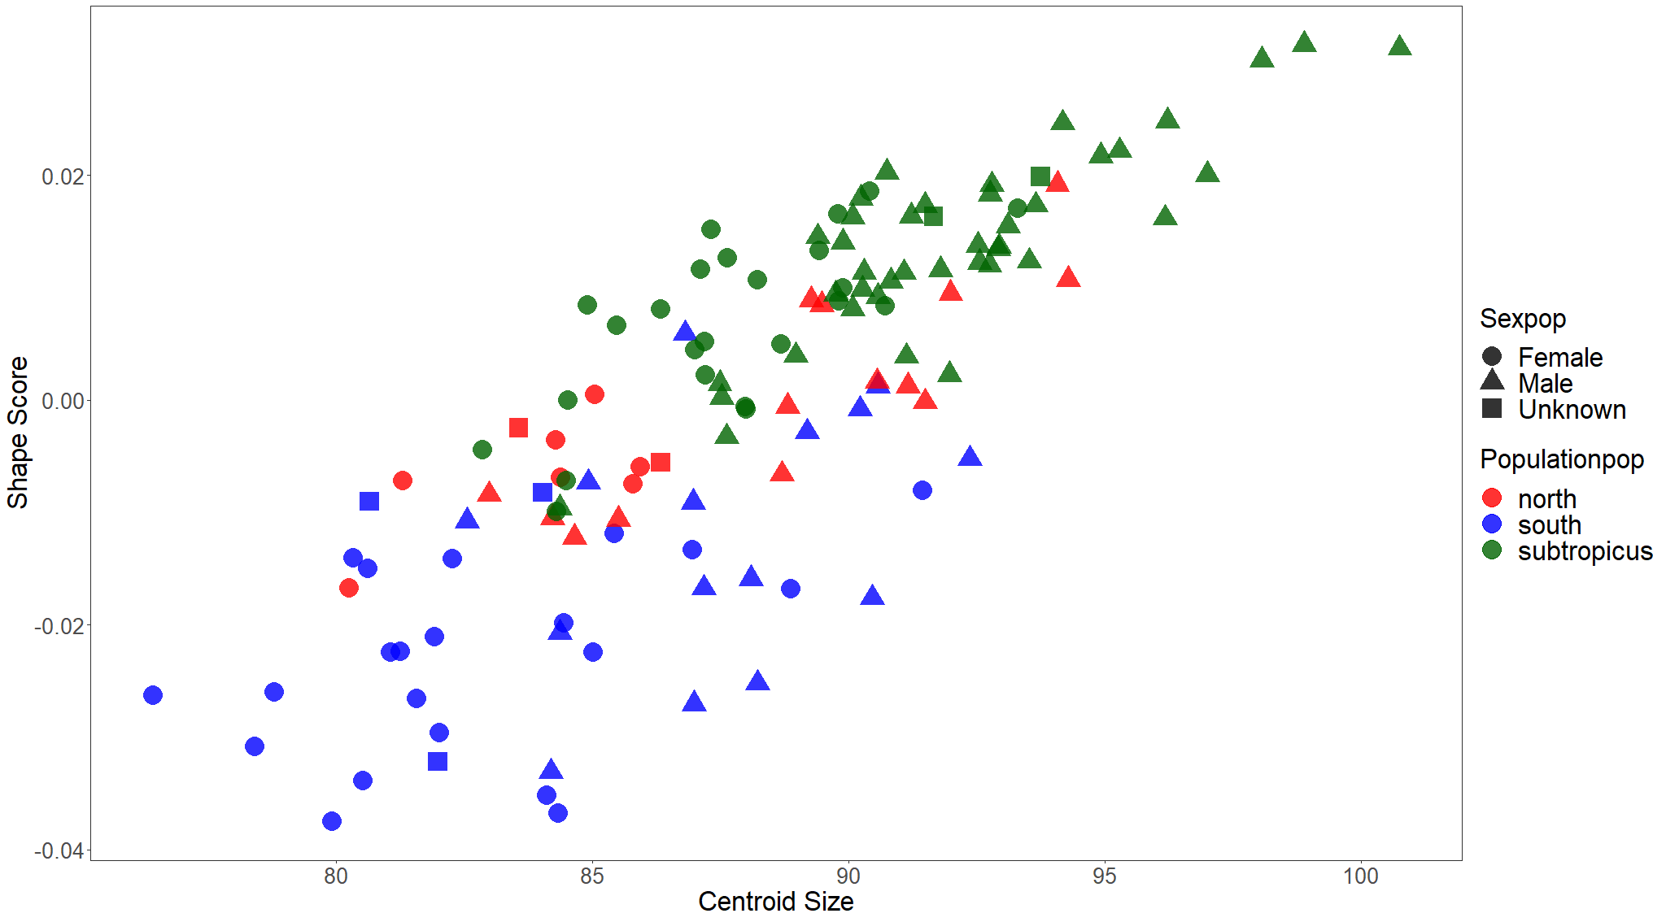
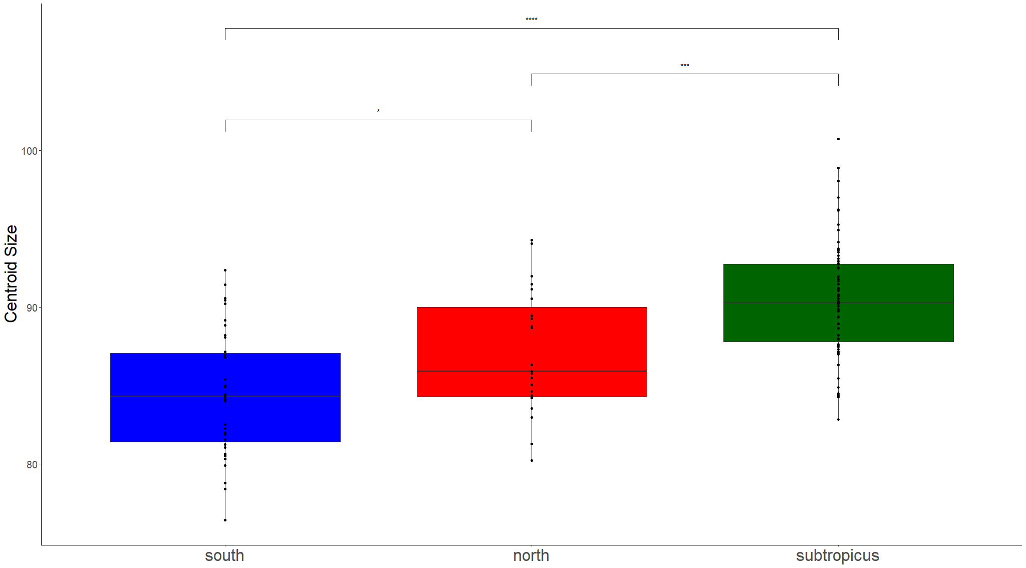
Procrustes ANOVA allometry (shape~size)
R² = 0.137
F_{1, 127} = 20.115
p = 0.001
Do they have unique allometries? (shape~size*population)
R² = 0.013
F_{2, 123} = 1.08
p = 0.267
Adjusting for size, are populations different in shape? (shape~size+population)
R² = 0.125
F_{2, 125} = 10.55
p = 0.001
Population identity as a predictor of size variation
Adj. R² = 0.338
F_{2, 126} = 32.096
p = 0.001

Slide 7
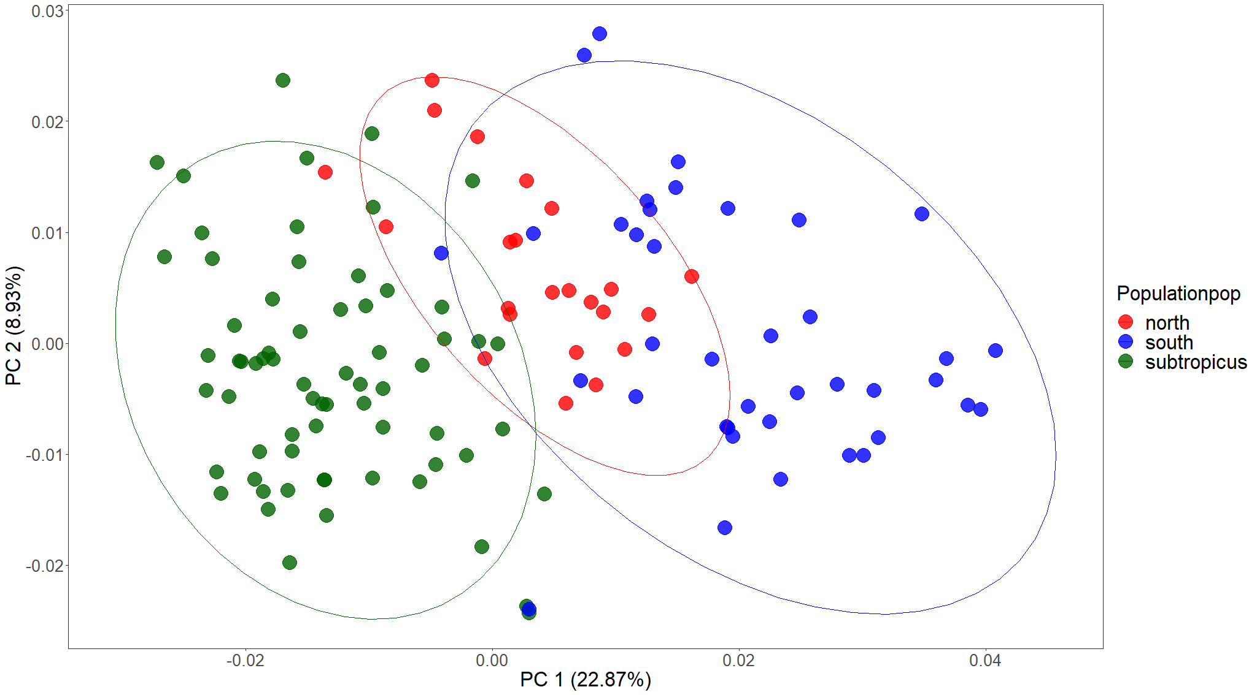
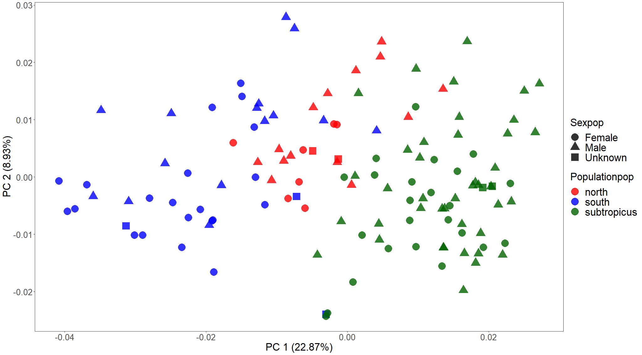
 | south | north | subtropicus
south
north | Mean shape: p = 0.001 Disparity: p = 0.058
subtropicus | Mean shape: p = 0.001 Disparity: p = 0.183 | Mean shape: p = 0.001 Disparity: p = 0.3
Procrustes ANOVA
Are populations different in shape? (shape~population)
R² = 0.202
F_{1, 127} = 15.9
p = 0.001

Slide 8
Response variable | Predictor variable | Question | SS | R² | F | Pr (>F) | Interpretation
Size | Latitude | Is latitude covarying with size in this dataset? | 717.86 | 0.262 | 45.138 | 0.001 | Clear effect.
 | Latitude within each population | Is latitude covarying with size within each population? | South: 19.45 North: 4.11 Sub: 4.61 | South: 0.033 North: 0.012 Sub: 0.005 | South: 1.254 North: 0.259 Sub: 0.341 | South: 0.294 North: 0.62 Sub: 0.582 | No clear effect.
 | Longitude | Is longitude covarying with size in this dataset? | 681.95 | 0.249 | 42.131 | 0.001 | Clear effect.
 | Longitude within each population | Is longitude covarying with size within each population? | South: 4.79 North: 59.92 Sub: 20.22 | South: 0.008 North: 0.178 Sub: 0.023 | South: 0.301 North: 4.53 Sub: 1.524 | South: 0.579 North: 0.043 Sub: 0.224 | No clear effect. North might have a biased sample.
Shape | Latitude | Is latitude covarying with shape in this dataset? | 0.027 | 0.167 | 25.526 | 0.001 | Clear effect
 | Latitude within each population | Is latitude covarying with shape within each population? | South: 0.003 North: 0.001 Sub: 0.002 | South: 0.072 North: 0.038 Sub: 0.024 | South: 2.874 North: 0.825 Sub: 1.626 | South: 0.001 North: 0.774 Sub: 0.025 | Only south stuartii is varying latitudinally in shape with low effect.
 | Longitude | Is longitude covarying with shape in this dataset? | 0.024 | 0.145 | 21.54 | 0.001 | Clear effect
 | Longitude within each population | Is longitude covarying with shape within each population? | South: 0.003 North: 0.001 Sub: 0.002 | South: 0.068 North: 0.063 Sub: 0.023 | South: 2.683 North: 1.407 Sub: 1.496 | South: 0.001 North: 0.076 Sub: 0.09 | Only south stuartii is varying longitudinally in shape with low effect.

Slide 9
 |  | Size |  |  |  | Shape
 | d. f. | SS | R² | F | Pr(>F) | SS | R² | F | Pr(>F)
Precipitation | 1 | 121.31 | 0.044 | 5.888 | 0.017 | 0.003 | 0.017 | 2.172 | 0.014
Temperature | 1 | 832.91 | 0.304 | 55.53 | <0.001 | 0.023 | 0.138 | 20.294 | 0.001
Elevation | 1 | 60.87 | 0.022 | 2.888 | 0.092 | 0.002 | 0.011 | 1.413 | 0.1
Distance to permanent water | 1 | 246.26 | 0.09 | 12.55 | 0.001 | 0.012 | 0.072 | 9.829 | 0.001

Slide 10
